Slide 1


Efficient Student Attendance System Using LBPH and OpenCV
This presentation provides an overview of a face recognition-based student attendance system, highlighting the use of Haar Cascade Classifier, Local Binary Patterns Histograms (LBPH), real-time attendance tracking, and a Tkinter-powered graphical user interface.
by
ANUBHAV LAL
RA2332241020061 MCA III ‘B’

Slide 2




Abstract
Face Recognition
Haar Cascade Classifier
LBPH Algorithm
Tkinter GUI
The system leverages computer vision techniques to accurately identify and track student attendance using facial features.
The Local Binary Patterns Histograms method is used for facial feature extraction and recognition.
A user-friendly graphical interface is developed using the Tkinter library to display attendance records and manage the system.
This algorithm is employed to detect and locate faces within the video feed, enabling real-time monitoring.

Slide 3

Automating Attendance with Facial Recognition
Traditional attendance systems are prone to errors, time-consuming, and inefficient. Our automated, face recognition-based system addresses these challenges, improving student engagement and administrative oversight.
Our system uses computer vision algorithms to identify and track attendance, eliminating manual roll calls and reducing human error. Real-time attendance data enables educators and administrators to monitor student participation and engagement effectively.
This technology streamlines administrative tasks, freeing up time for educators to focus on instruction and student support. It also fosters a more efficient and engaging learning environment by minimizing interruptions and providing valuable insights into student attendance patterns, which can be used to identify potential academic or personal challenges.

Slide 4

Hardware & Software Requirements
Hardware
Software
Desktop or laptop computer with a modern Intel or AMD processor
Python 3.x programming language
OpenCV computer vision library for face detection and recognition
Webcam or camera module with at least 720p resolution
Tkinter GUI toolkit for building the user interface
Reliable high-speed internet connection for accessing cloud services
Haar Cascade Classifier for real-time face detection
Solid-state drive (SSD) or hard disk drive (HDD) with sufficient storage space to store attendance logs
Local Binary Patterns Histogram (LBPH) Face Recognizer for facial recognition
Pandas data analysis library for processing and analyzing attendance data

Slide 5

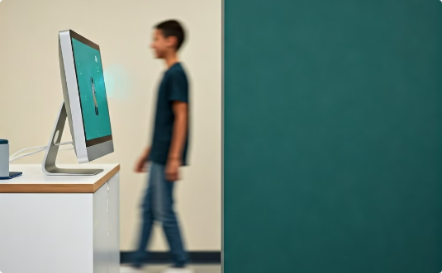

Existing vs Proposed System
Traditional Attendance
Proposed System
Key Benefits
Manually taken by instructors, prone to human error and time-consuming.
Automated face recognition for accurate and efficient real-time attendance tracking.
Eliminates manual attendance recording
Provides detailed attendance analytics
Enhances classroom management

Slide 6

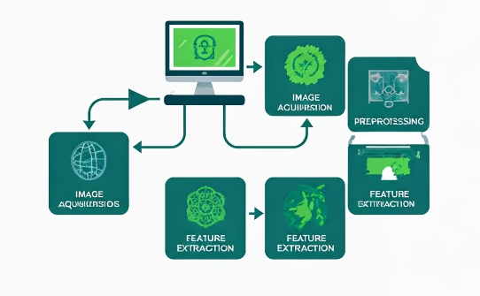

Face Detection with OpenCV Haar Cascade
Haar Cascade Classifier
Real-Time Face Detection
Classroom Application
OpenCV's Haar Cascade Classifier is a machine learning-based approach for object detection, which is highly effective in identifying faces in real-time video streams.
The Haar Cascade algorithm scans the video frame, recognizing facial features and patterns to accurately locate and track people's faces.
By integrating this face detection technology, the system can seamlessly automate attendance tracking, enhancing classroom management and student engagement.

Slide 7
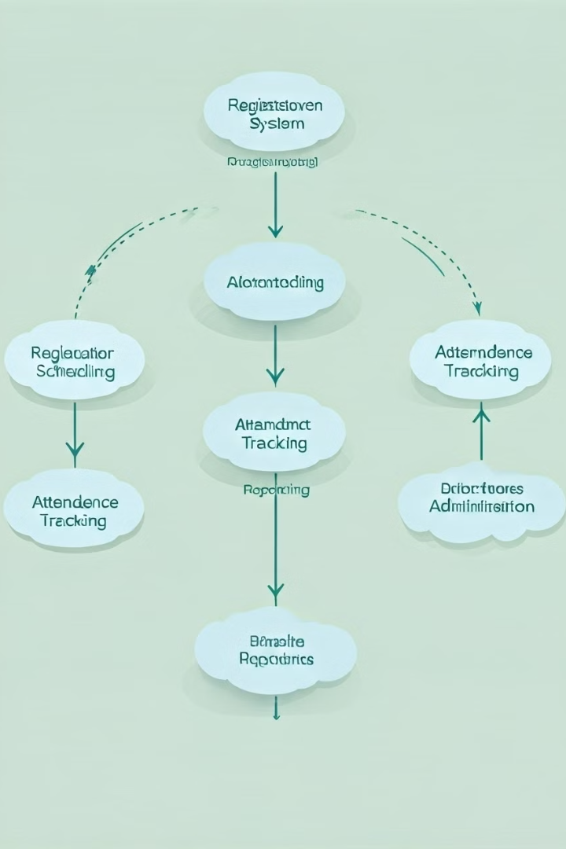
Module Description
1
Face Detection
Utilizes Haar Cascade Classifier to locate and identify faces in the video feed.
2
Feature Extraction
Applies the LBPH algorithm to extract unique facial features for recognition.
3
Attendance Tracking
Records student attendance by matching detected faces to enrolled student profiles.

Slide 8

LBPH Face Recognizer
The LBPH (Local Binary Patterns Histograms) face recognizer is a powerful algorithm for recognizing and matching student faces in the attendance system. It extracts unique facial features, such as edges, corners, and textures, and encodes them into a compact histogram representation.
This histogram-based approach allows the system to accurately identify and verify students, even in the presence of varying lighting conditions, angles, and facial expressions, making it a robust solution for real-time attendance tracking.

Slide 9
Real-Time Attendance Tracking and CSV Storage
Face Detection
1
The system continuously scans the classroom video feed, using OpenCV's Haar Cascade Classifier to detect and locate student faces in real-time.
2
Feature Extraction
The detected faces are then analyzed using the LBPH algorithm, which extracts unique facial features and encodes them into a compact histogram representation.
Attendance Marking
3
The extracted facial features are matched against the enrolled student profiles to accurately mark attendance, updated in real-time.
4
CSV Data Storage
The attendance records are seamlessly logged into a CSV file, providing a comprehensive and easily accessible attendance history for each class.

Slide 10

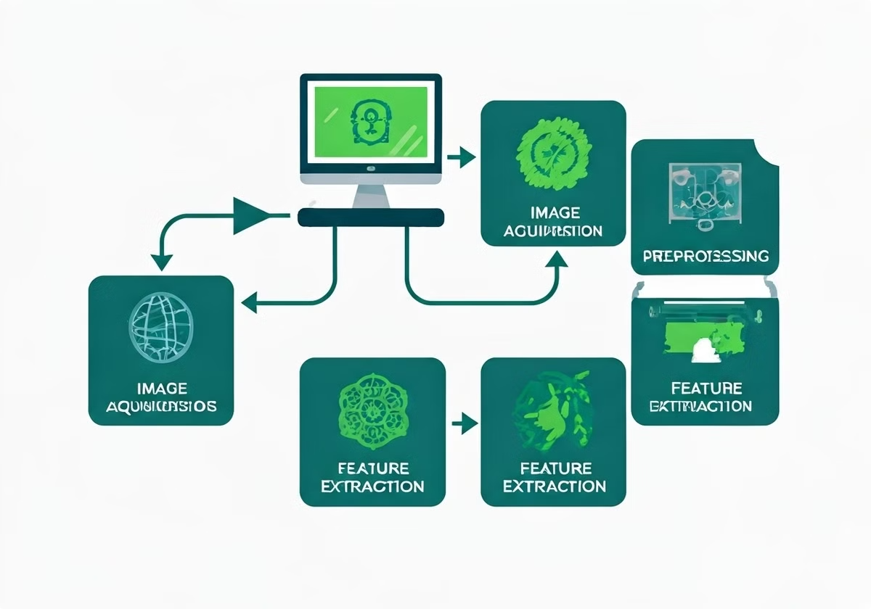
Architecture Diagram
Video Capture
Face Detection
Acquires real-time video feed from the connected camera.
Employs Haar Cascade Classifier to detect and locate faces in the video.
Feature Extraction
Attendance Tracking
Applies the LBPH algorithm to extract unique facial features for recognition.
Matches detected faces to enrolled student profiles and records attendance.

Slide 11

GUI Module
User-Friendly Attendance Monitoring
The intuitive Tkinter-based GUI allows teachers to easily select subjects and monitor student attendance in real-time. With a clean and responsive interface, educators can quickly view class rosters, track tardiness, and generate detailed attendance reports.

Slide 12
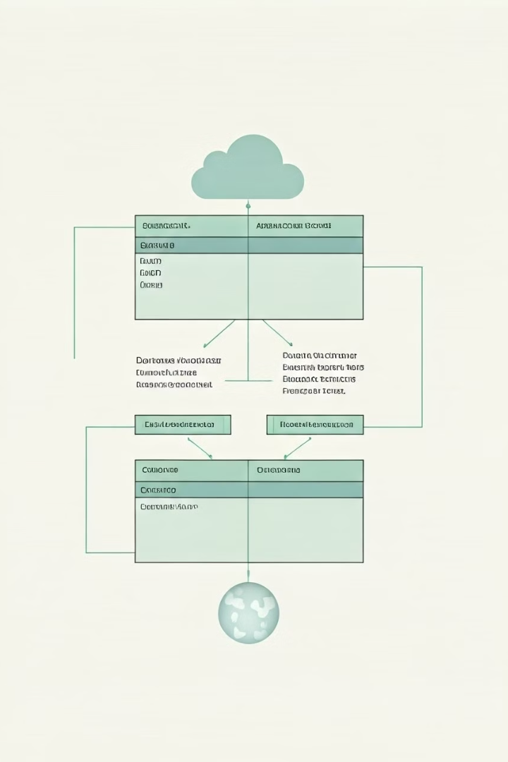
Database Design
Students
Stores student information, including name, ID, and facial features.
Attendance
Records attendance data, such as date, time, and student ID.
Courses
Maintains information about the courses and associated students.

Slide 13





Code Walkthrough
Video Capture
Initialize the video capture device and start the feed.
Face Detection
Apply the Haar Cascade Classifier to detect and locate faces in the video.
Feature Extraction
Use the LBPH algorithm to extract unique facial features for recognition.
Attendance Tracking
Match detected faces to enrolled student profiles and record attendance data.

Slide 14
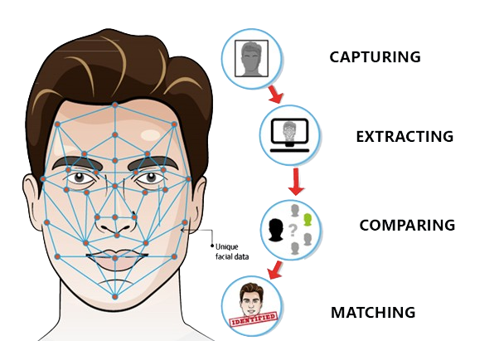

Screenshot Demos
Face Detection and Recognition
Attendance Monitoring
The system accurately detects and recognizes students in real-time using the Haar Cascade Classifier and LBPH algorithm.
The Tkinter-based GUI provides a user-friendly interface to view and manage student attendance data.

Slide 15
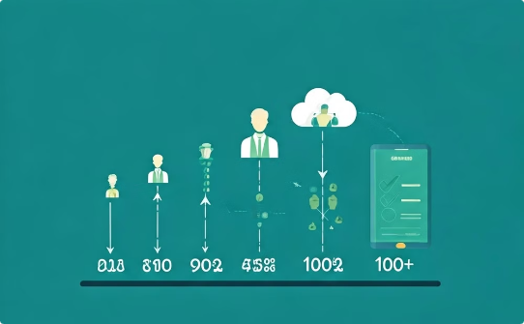


Conclusion and Future Enhancements
Scalability
Advanced Analytics
Mobile Integration
The system can be scaled to accommodate larger class sizes and multiple classrooms.
Implement sophisticated data analysis and reporting capabilities for better insights.
Develop a mobile application for seamless attendance tracking and management.
The proposed face recognition-based attendance system offers a reliable, efficient, and scalable solution to automate student attendance tracking. By leveraging Haar Cascade Classifier and LBPH algorithms, the system delivers accurate real-time monitoring and detailed analytics. Future enhancements can focus on scalability, advanced data analysis, and mobile integration for enhanced classroom management.

